Slide 1
Growing Plants Investigation
https://www.youtube.com/watch?v=H9MV5CgPgIQ

Slide 2
The Problem
PLANTS NEED LIGHT TO PRODUCE THEIR OWN ENERGY Plants in different environments are effected by the light available to them. The light available to a plant may be changed by other plants around it, buildings around it, the weather or how close the plant is ot the north/south pole.
Your group needs to investigate how light effects plant growth. Some ideas to get you started. The position of light The amount of light

Slide 3
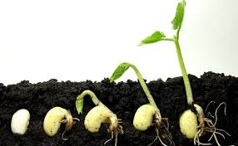
Planning
AIM: A short sentence describing briefly what you are trying to find out from the experiment. The purpose.
To find out if…
HYPOTHESIS: A statement that can be tested.
The plant grown in a dark/light environment will grow faster/slower/bigger/smaller/longer/greener
EQUIPMENT: This must be a list of all equipment you intend to use.
PROCEDURE: A simple step by step guide of how the experiment will be conducted.

Slide 4
Results
OBSERVATIONS: are qualitative descriptions of what you actually see, hear, smell and touch during an experiment.
RESULTS: Measurements taken during the experiment recorded in a table.
PROCESSING OF RESULTS: This may be a graph or table created once the experiment has finished.

Slide 5
Evaluating
CONCLUSION: The conclusion for the experiment should relate to the to the aim or purpose of the experiment. It should answer the question asked or implied in the aim.
EVALUATION: This is a reflection of the experiment
Was it valid?
Was it accurate?
What were the errors?
How was the teamwork?

